Slide 1
Amy Tate
March 31, 2026
Notes:
Hello, and thank you for the opportunity to speak with you today. I’d like to discuss a bit about TVA’s history and our ongoing mission of service.​

Slide 2
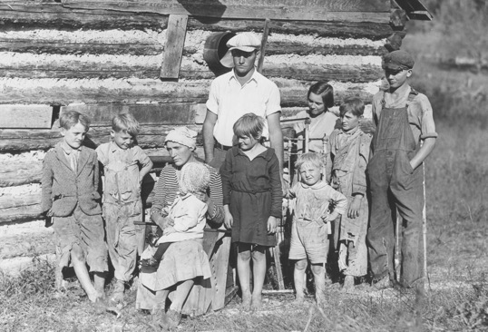
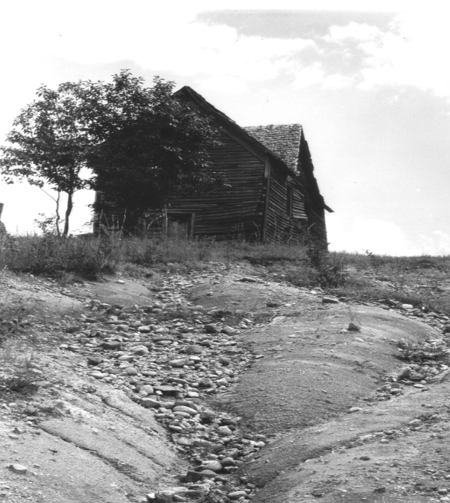
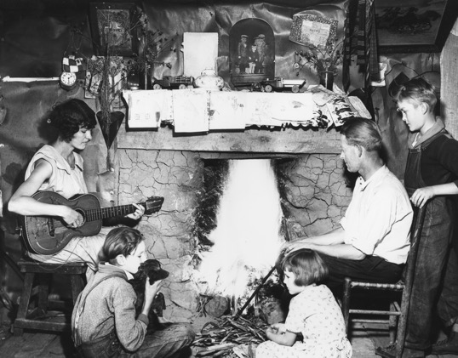
A Region in Peril
Challenges across the Tennessee Valley:
Poverty
Flooding
Poor farming
Lagging infrastructure
Limited economic opportunity
Notes:
In the early 20th Century, even before the Great Depression, the Tennessee Valley region was one of the poorest areas in America. It faced severe economic, ecological, and social challenges, in large part due to the flooding of the Tennessee River, which destroyed topsoil –– a devastating effect in an agricultural society.

Slide 3
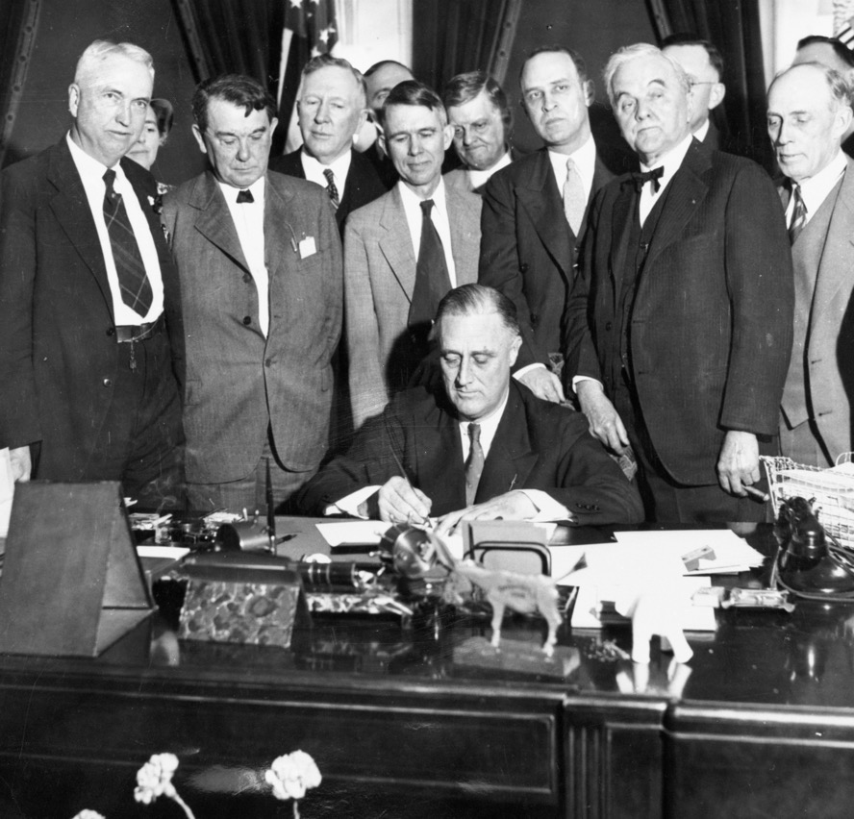
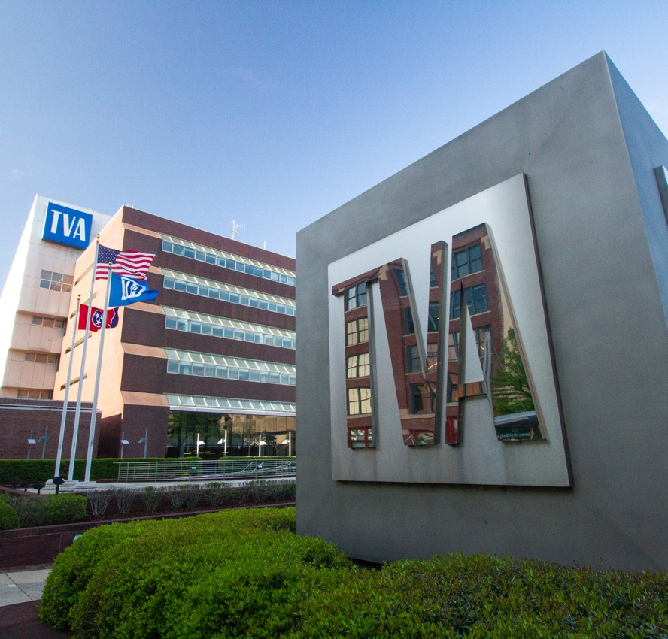
An Innovative National Solution
Notes:
In 1933, during the Great Depression, President Franklin D. Roosevelt established the Tennessee Valley Authority. It would, he said, benefit “the general social and economic welfare of the Nation.” ​
​
Its first aim was to improve living and economic conditions in the seven Southeastern states we serve, by providing affordable electricity, controlling the Tennessee River, and promoting soil conservation.

Slide 4
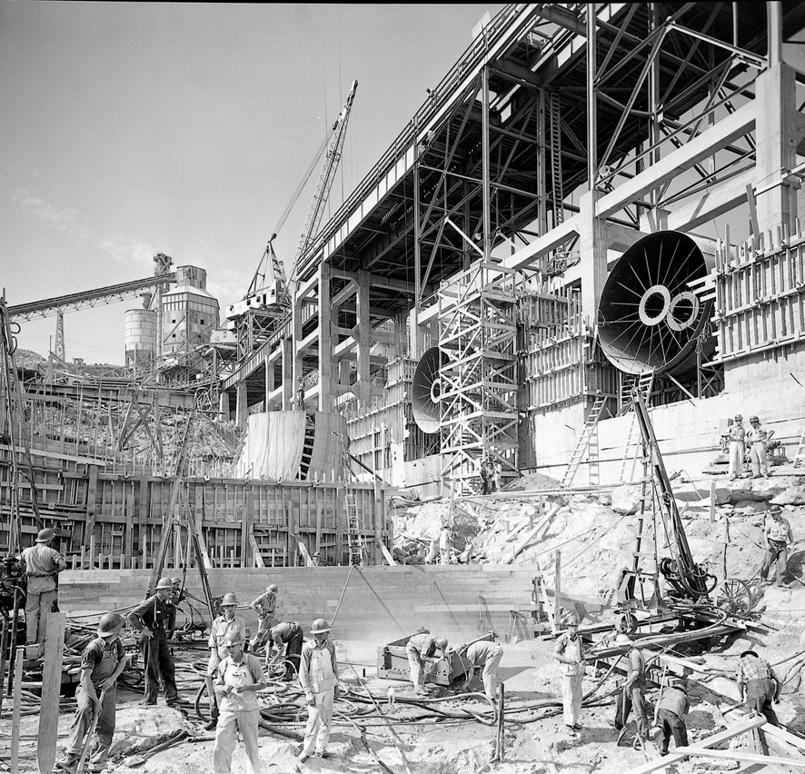
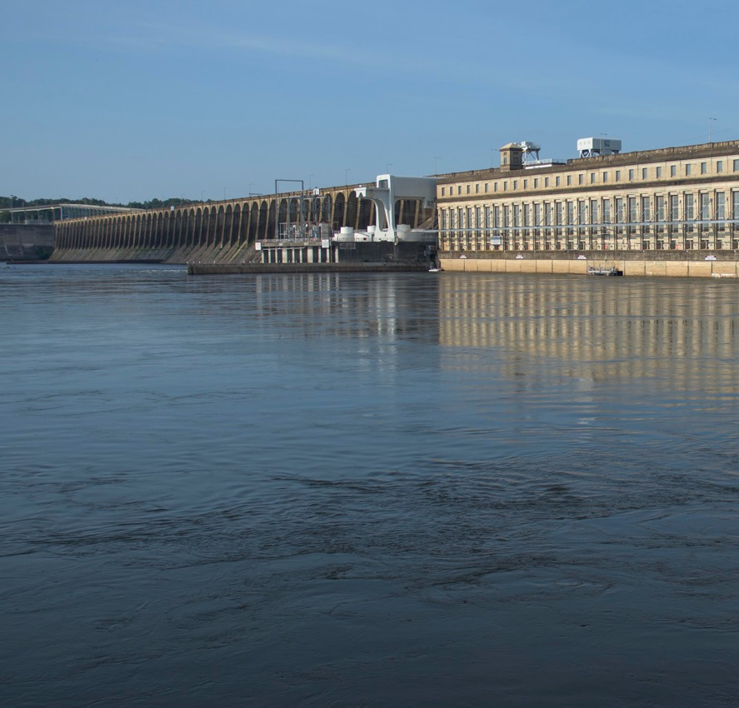
Step One: Taming the Tennessee Watershed
Notes:
In its earliest days, TVA built a network of dams and reservoirs along the Tennessee River and its tributaries. They controlled flooding, improved navigation, and began to alleviate the economic and environmental struggles that had held back the region for decades.​

Slide 5
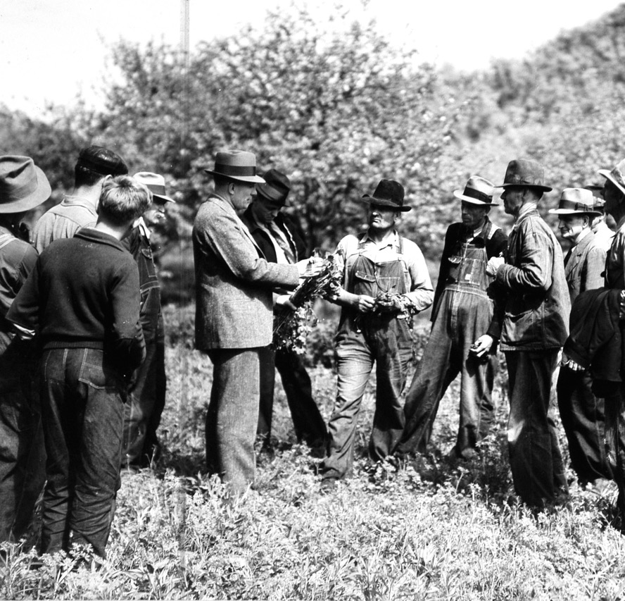
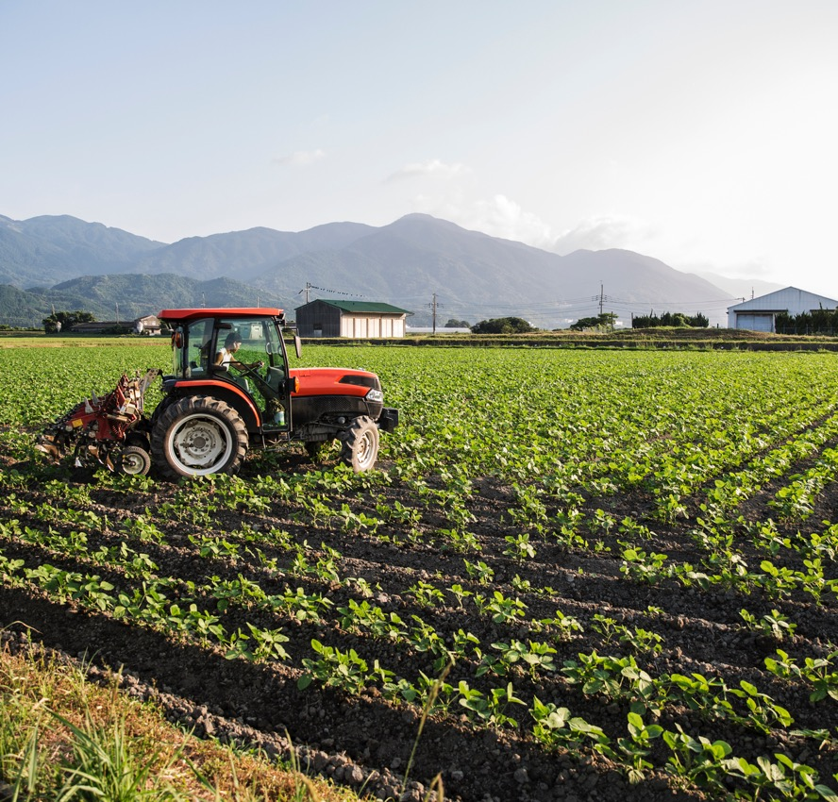
Improving Farming, Feeding the World
Notes:
TVA also demonstrated a public-minded sense of innovation. In the 1930s it developed inventions, such as new fertilizers for cropland, that revolutionized agriculture in the Tennessee Valley region, lifting people out of poverty. And over the decades that followed, these innovations spread. First around a growing nation seeking to modernize its farming. Then around the world, especially benefitting regions with underdeveloped cropland. ​

Slide 6
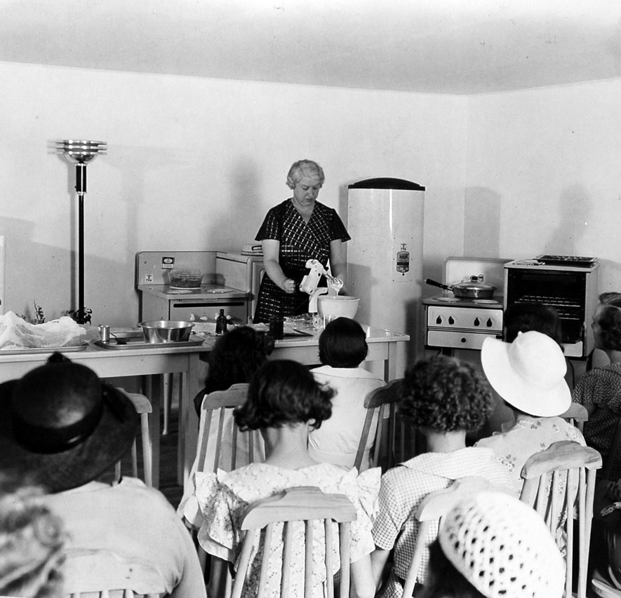

Electricity to Change Daily Life
Notes:
Thanks to the hydropower of its dams, TVA introduced electricity to the Tennessee Valley region, supporting early manufacturing. It also undertook campaigns to introduce modern appliances and conveniences that are now part of daily life: lights, heating, ovens, refrigerators and washing machines, as well as public improvements such as streetcar systems and street lighting. ​

Slide 7
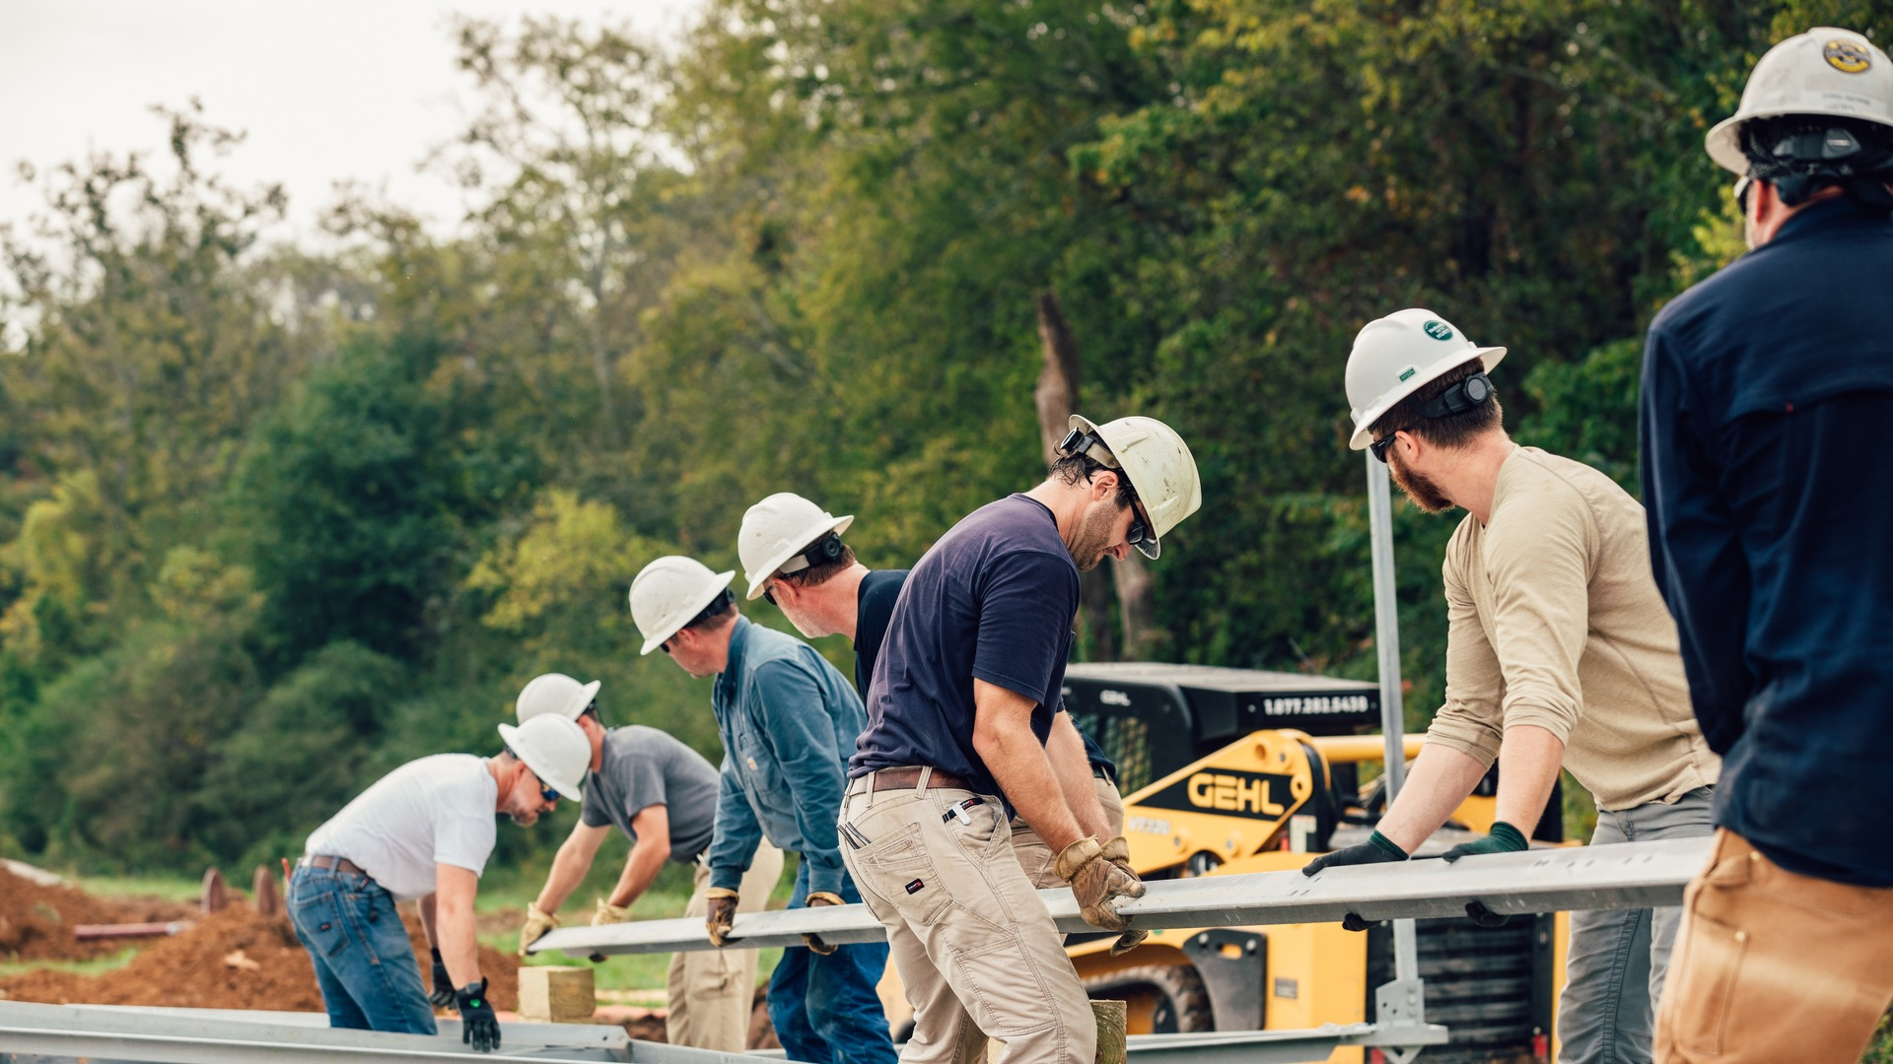
Our Mission
To serve the people of the
Tennessee Valley to make life better.
Notes:
We are the nation’s largest public power provider, serving more than 10 million customers over an 80,000-square-mile region. That service area reaches seven states: Tennessee, Alabama, Mississippi, Kentucky, Georgia, North Carolina, and Virginia. TVA is self-financed and receives no recurring taxpayer funding, operating similar to a private corporation while still being wholly owned by the federal government. ​
​

Slide 8
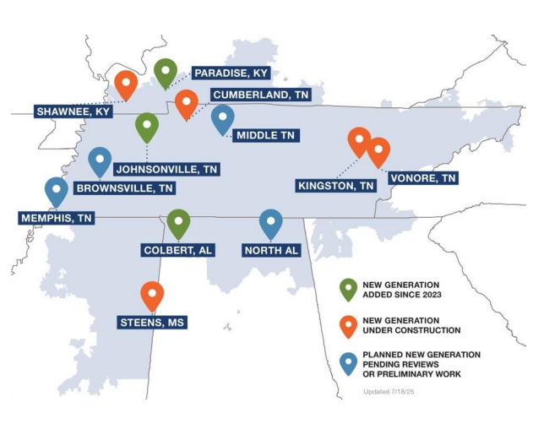



Building America’s Energy Future
POTENTIAL NEW GENERATION PENDING REVIEWS OR PRELIMINARY WORK
NEW GENERATION ADDED SINCE 2023
NEW GENERATION UNDER CONSTRUCTION
Paradise, Kentucky 681 MW, frame combustion turbine Colbert, Alabama 681 MW, frame combustion turbine Johnsonville, Tennessee 500 MW, aeroderivative combustion turbine |  | Vonore, Tennessee 20 MW / 40 MWh battery storage Cumberland, Tennessee 1,450 MW, combined cycle Kingston, Tennessee 1,500 MW, natural gas generation (energy complex) Shawnee, Kentucky 100 MW, solar Steens, Mississippi (New Caledonia) 500 MW, proposed frame combustion turbine |  | Memphis, Tennessee (Allen) 200 MW, proposed aeroderivative combustion turbine Middle Tennessee 900 MW, proposed gas generation Brownsville, Tennessee (Lagoon Creek) 350 MW energy complex North Alabama 1,200 MW hydro pumped storage
8
Notes:
Initial Events
Kingston – May 27 - show gas and coal site
Shawnee – June 18 – show solar and coal work
Cumberland July 15-or 16 – show gas and coal site
Also looking at other events – Substations, transmission projects etc.
These can be monthly and as simple as a photo and submitting to the local paper.

Slide 9
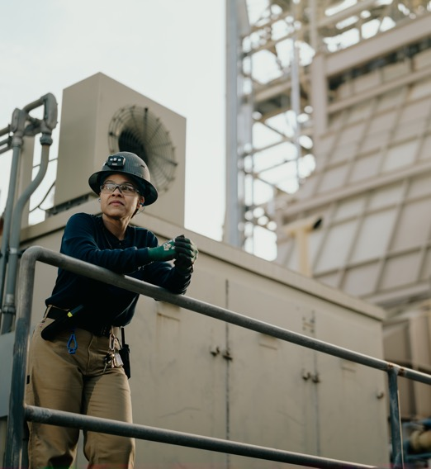

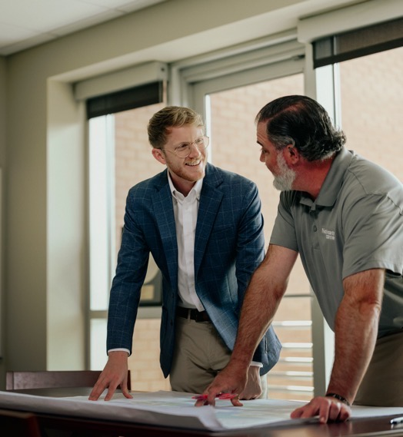
Delivering on Our Mission to You
Energy | Environment | Economic Development
Provide affordable, reliable power. |  | Steward the Valley’s natural resources. |  | Partner for economic growth.
Notes:
TVA’s mission remains unchanged in more than 90 years: To provide affordable, reliable power. To steward the Valley’s natural resources. And to aid in the region’s economic growth.

Slide 10
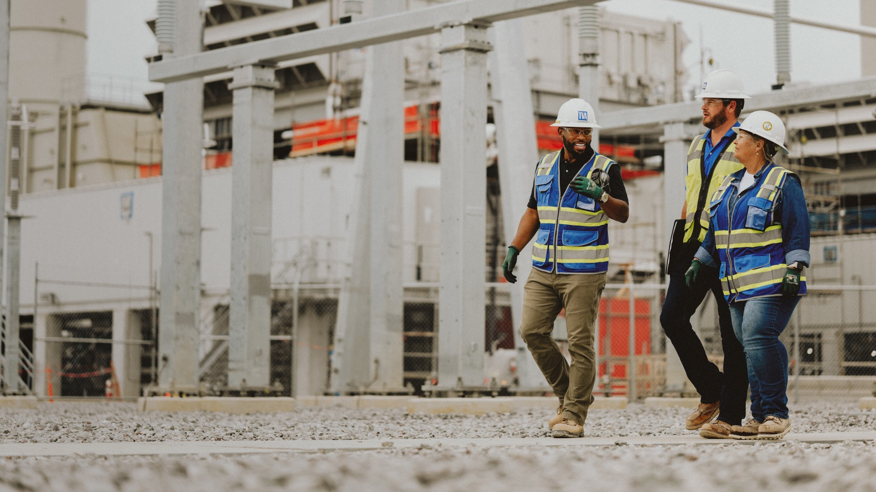

National
Energy
Leadership
Largest US public power provider
One of the nation’s largest power
generation/distribution systems
Leader in energy security – rates and reliability
Leader in carbon-free energy
International model for integrated river
and public land management
Notes:
TVA’s current power generation portfolio demonstrates the importance of diversity, deploying everything from traditional resources like hydroelectric dams, coal-fired plants, and natural gas facilities to renewable energy sources like solar. ​
​
We also have one of the largest nuclear fleets in the nation. Our nuclear plants meet the needs of our customers with affordable, reliable, carbon-free power, supplying approximately 40 percent of TVA’s energy annually. ​
​
TVA and its partners lead the way in research into future forms of generation, such as small modular nuclear reactors at our Clinch River site and supporting development of other advanced nuclear technologies. Another example of this is that we’re building the first TVA-owned battery storage facility in Vonore, Tennessee.

Slide 11
Governance

Slide 12
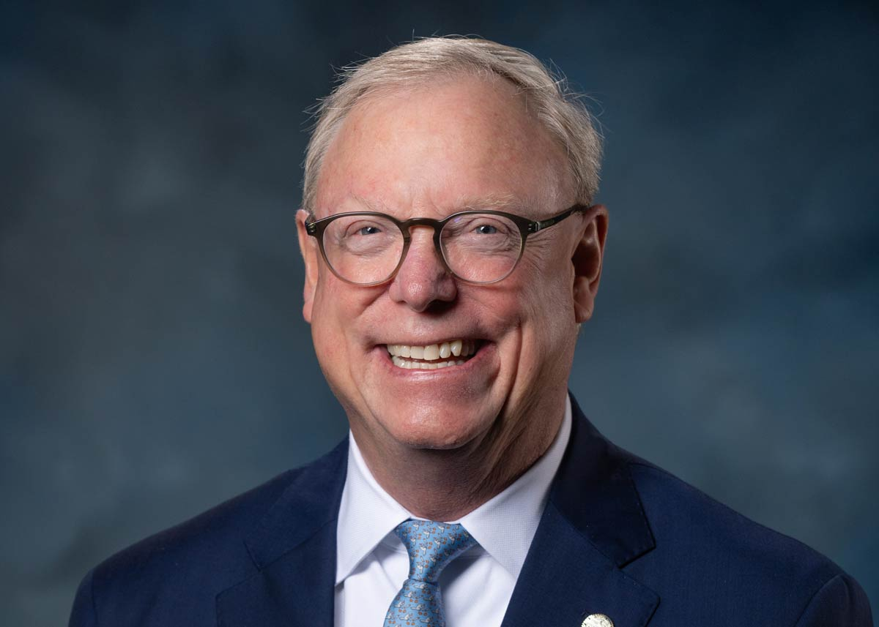
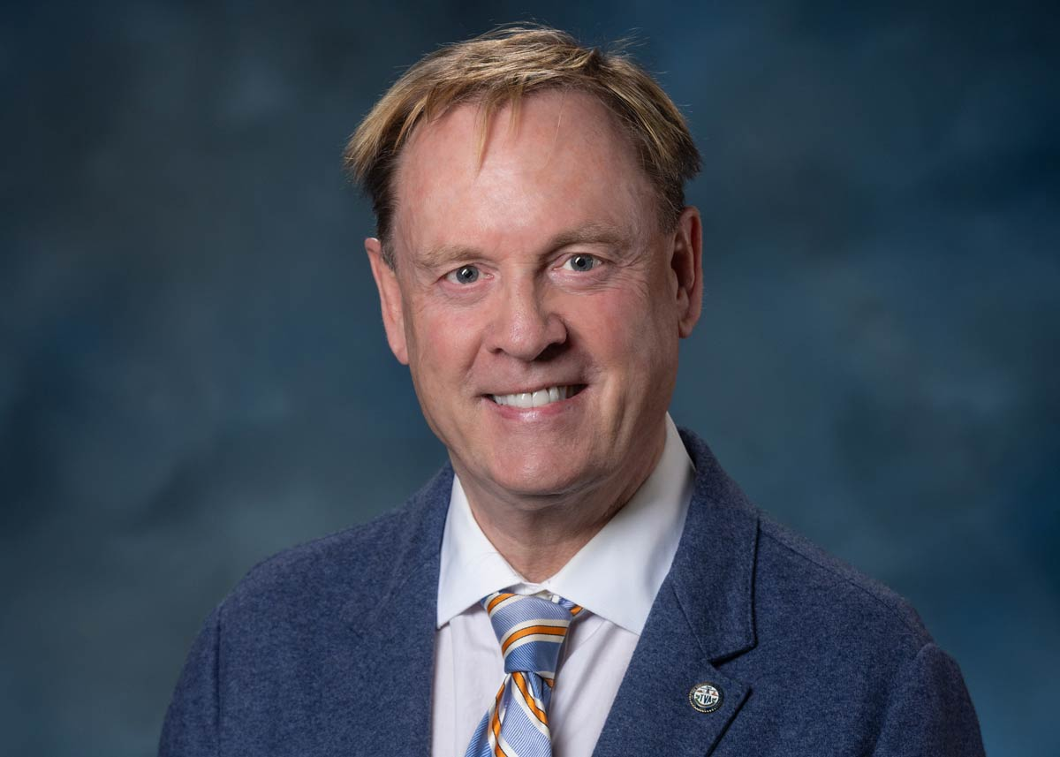
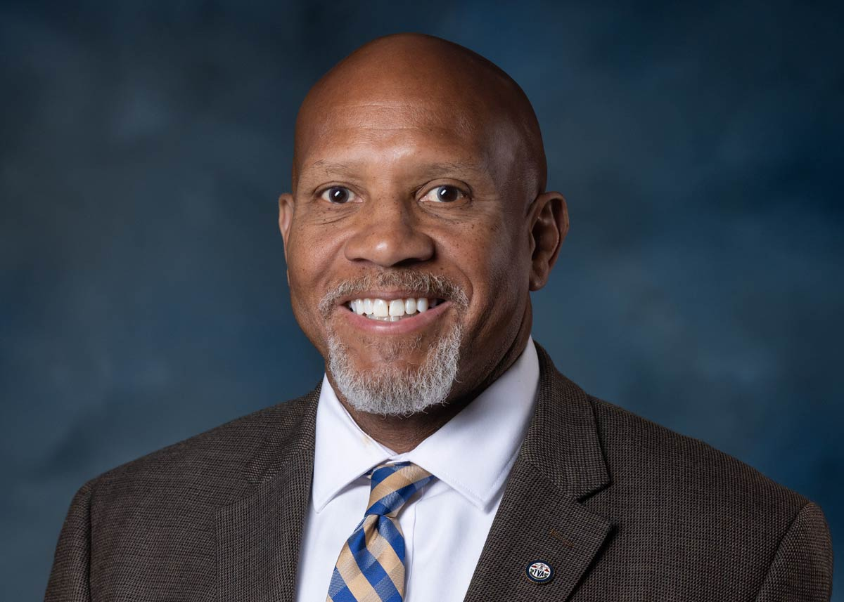
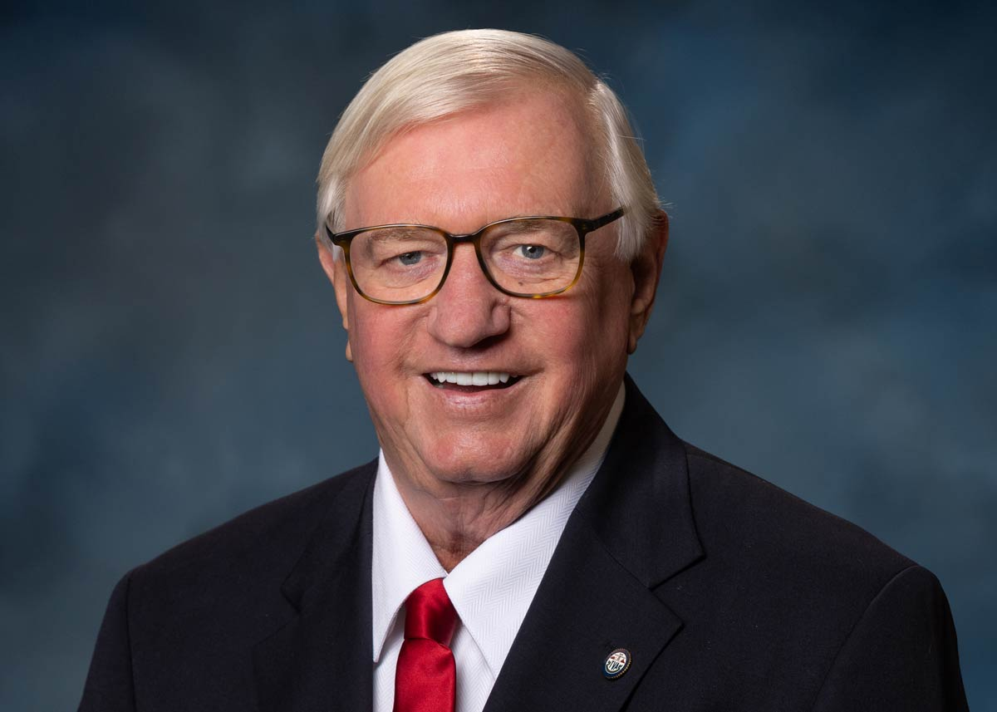
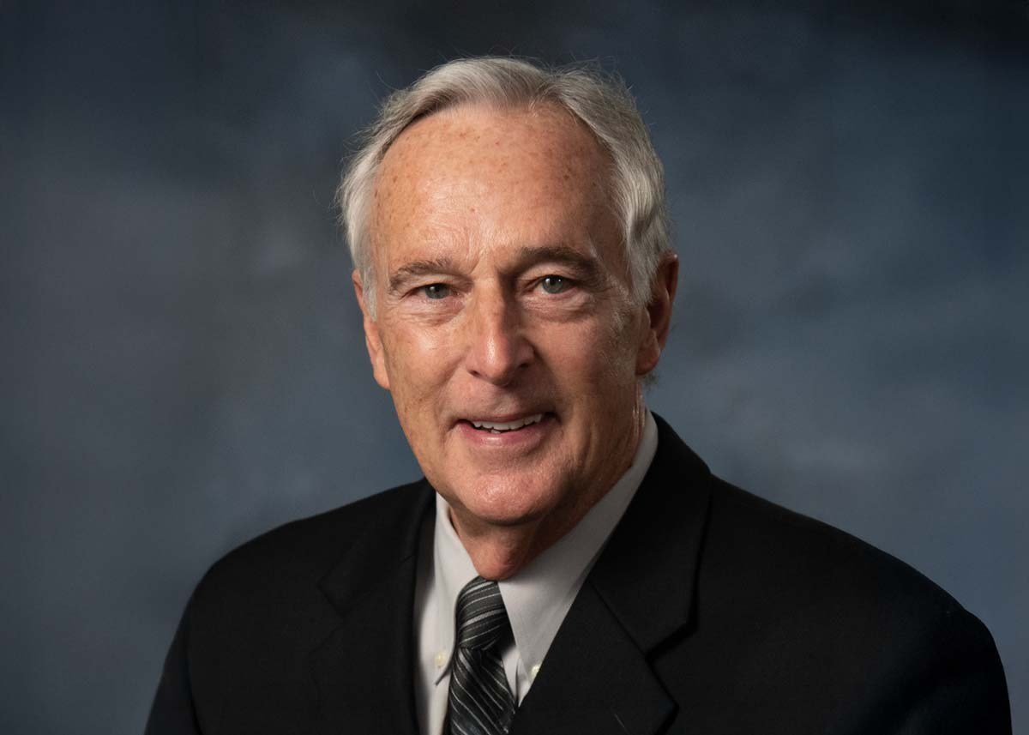
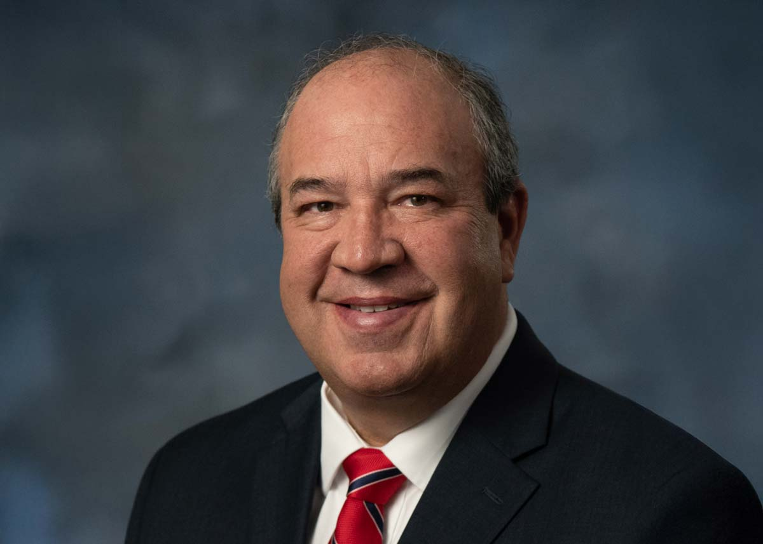
Six New TVA Directors
Board of Directors - Update
Chair Mitch Graves
Chair-elect Jeff Hagood
Art Graham
Randy Jones
Bobby Klein
Wade White

Slide 13
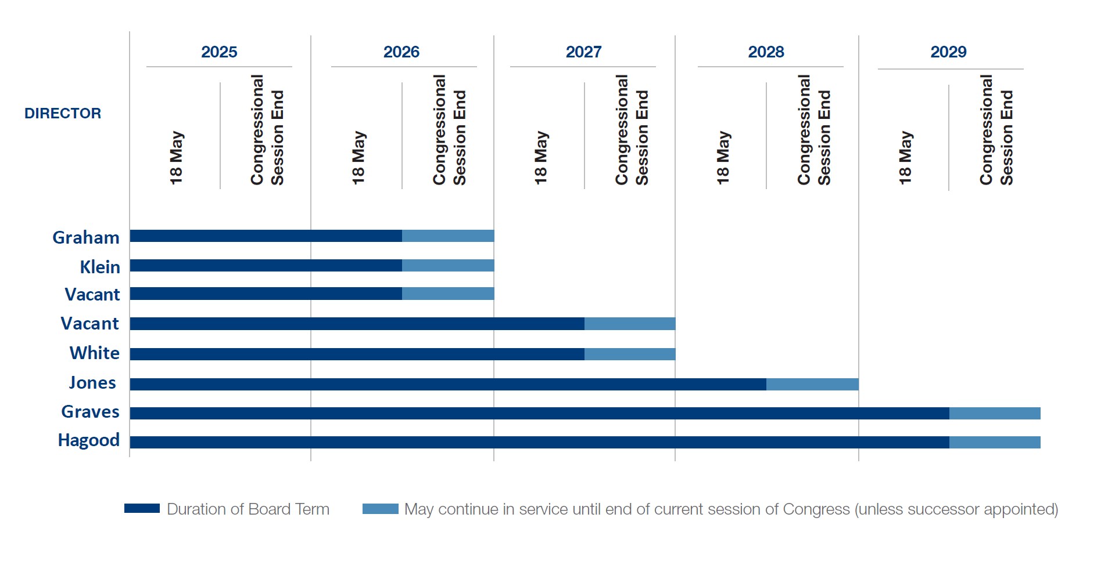
TVA Board Director Terms
TVA Restricted Information – Deliberative and Pre-Decisional

Slide 14
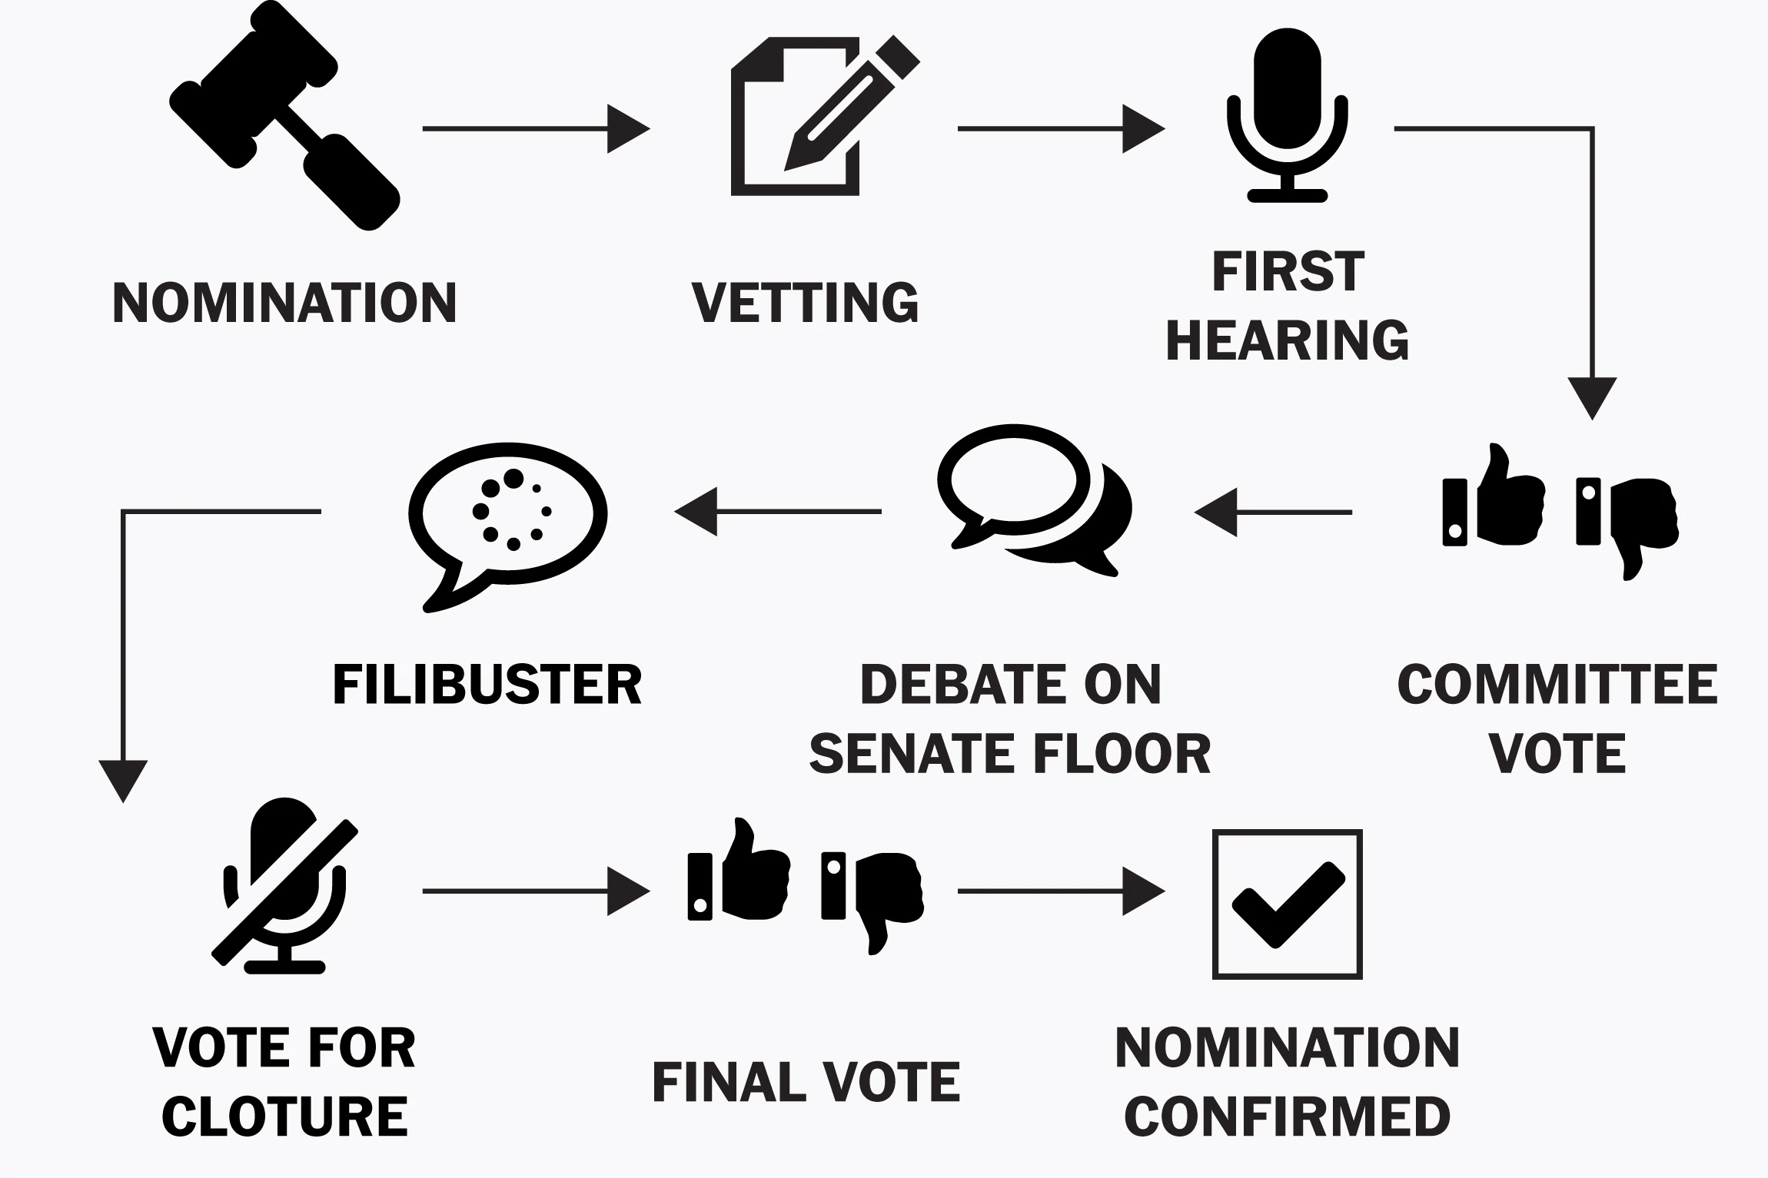
Overview of Nomination to Confirmation Process
TVA Restricted Information – Deliberative and Pre-Decisional

Slide 15
Government & Community Relations

Slide 16





Federal Stakeholders
Executive Branch
Legislative Branch
National Trade Associations
POTUS
White House Climate Policy Office
Environmental Protection Agency
Department of State
Department of Energy
Department of Labor
Department of Treasury
Department of the Interior
Department of Homeland Security
Securities & Exchange Commission
Internal Revenue Service
U.S. Government Accountability Office
U.S. General Services Administration
U.S. Office of Personnel Management
Federal Energy Regulatory Commission
Nuclear Regulatory Commission
Appalachian Regional Commission
American Public Power Association
National Rural Electric Coop Association
Edison Electric Institute
Electric Power Research Institute
Nuclear Energy Institute
U.S. Senate
U.S. House of Representatives
Congressional Committees of Jurisdiction:
  Senate Environment & Public Works
  House Transportation & Infrastructure
Congressional Committees of Interest:
  Senate Energy & Natural Resources
  House Energy & Commerce

Slide 17
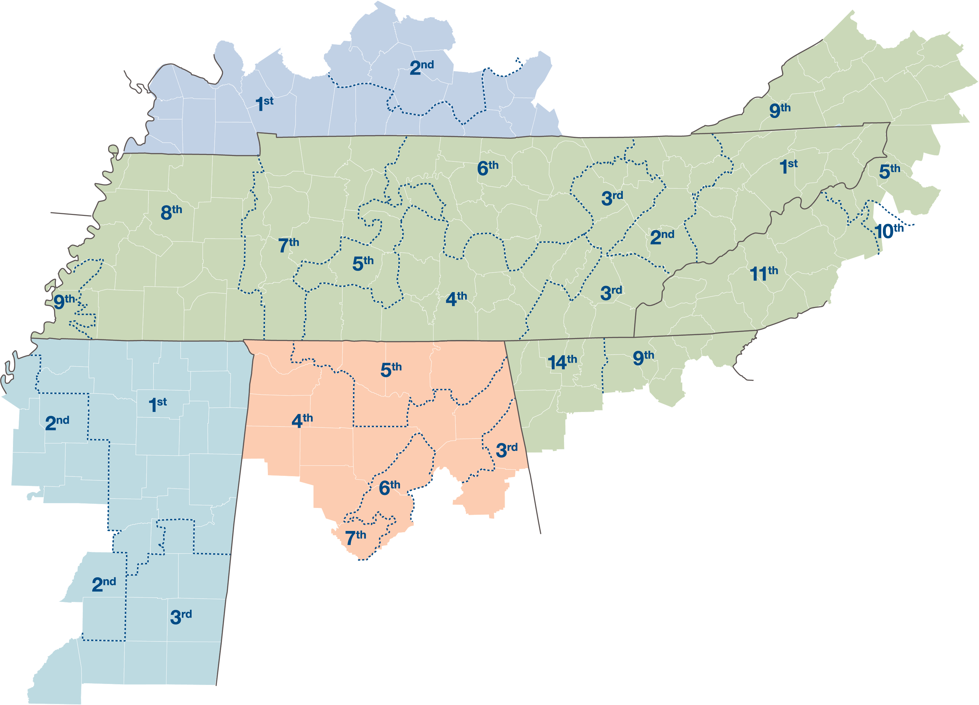
TVA Congressional Delegation
KENTUCKY
GREATER EAST
1st - James Comer (R-KY)
2nd - Brett Guthrie (R-KY)
5th - Harold “Hal” Rogers (R-KY)
Senator Mitch McConnel (R-KY)
Senator Rand Paul (R-KY)
VIRGINIA
9th - Morgan Griffith (R-VA)
Sen. Mark Warner (D-VA)
Sen. Tim Kaine (D-VA)
GEORGIA
9th - Andrew Clyde (R-GA)
11th – Barry Loudermilk (R-GA)
14th – VACANT
Sen. Raphael Warnock (D-GA)
Sen. Jon Ossoff (D-GA)
NORTH CAROLINA
5th - Virginia Foxx (R-NC)
11th - Chuck Edwards (R-NC)
14th - Tim Moore (R-NC)
Sen. Thom Tillis (R-NC)
Sen. Ted Budd (R-NC)
MISSISSIPPI
1st - Trent Kelly (R-MS)
2nd - Bennie Thompson (D-MS)
3rd - Michael Guest (R-MS)
Sen. Cindy Hyde-Smith (R-MS)
Sen. Roger Wicker (R-MS)
TENNESSEE
ALABAMA
1st - Diana Harshbarger (R-TN)
2nd - Tim Burchett (R-TN)
3rd - Chuck Fleischmann (R-TN)
4th - Scott DesJarlais (R-TN)
5th - Andy Ogles (R-TN)
6th - John Rose (R-TN)
7th – Matt Van Epps (R-TN)
8th - David Kustoff (R-TN)
9th - Steve Cohen (D-TN)
Sen. Bill Hagerty (R-TN)
Sen. Marsha Blackburn (R-TN)
3rd – Mike Rogers (R-AL)
4th - Robert Aderholt (R-AL)
5th - Dale Strong (R-AL)
6th - Gary Palmer (R-AL)
7th - Terri Sewell (D-AL)
Sen. Tommy Tuberville (R-AL)
Sen. Katie Britt (R-AL)
17
TVA Internal Use Only

Slide 18
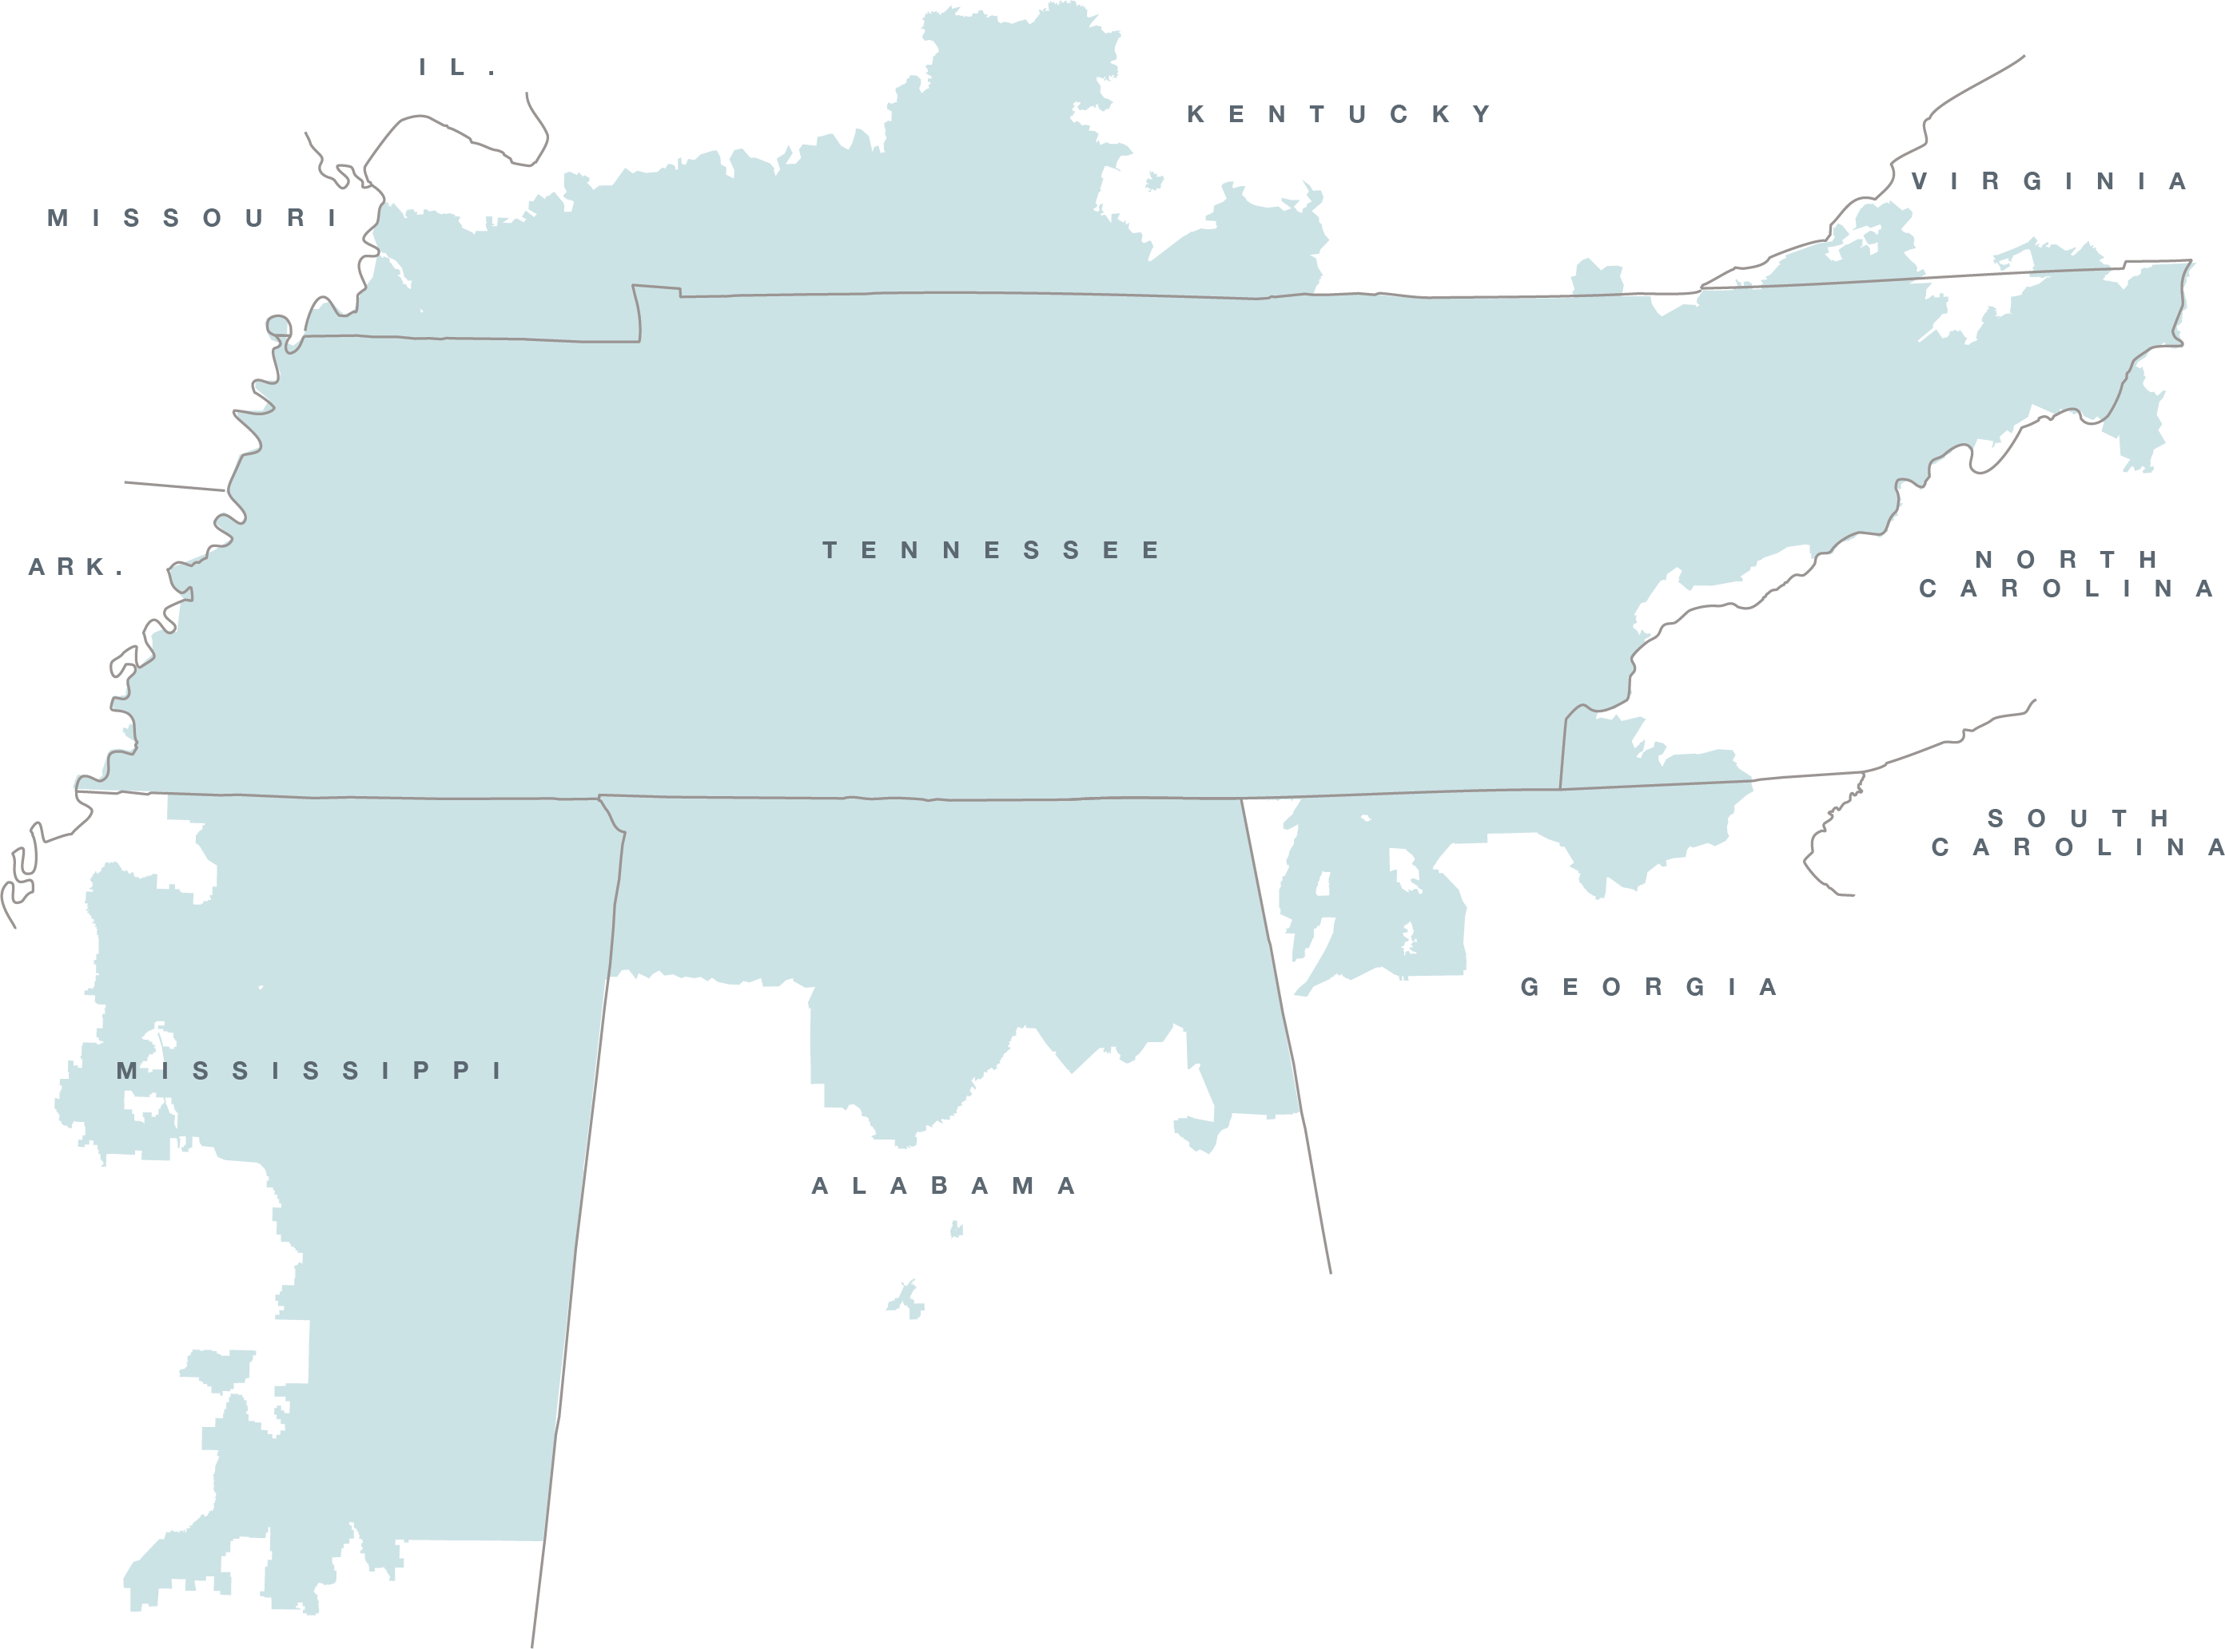
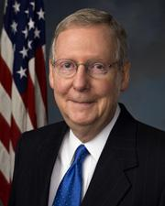
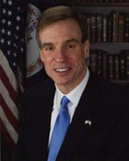
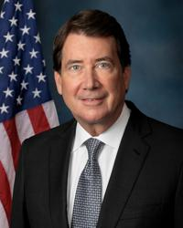
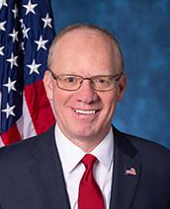
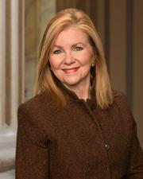
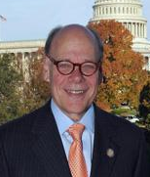
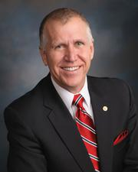
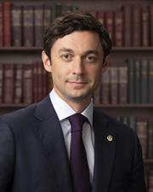
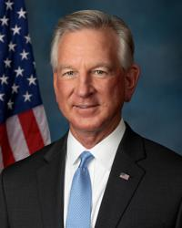
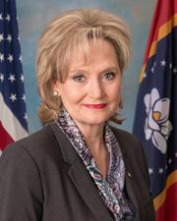
TVA Delegation: Active in the Mid-terms
Sen. Mitch McConnell
(R-KY) is retiring from the Senate.
Sen. Mark Warner (D-VA) is running for re-election.
Sen. Marsha Blackburn (R-TN) is running for governor.
If successful, she could appoint her replacement.
  This could be a TN House member, causing additional changes in the delegation.
.
Sen. Bill Hagerty (R-TN) is running for re-election.
Rep. John Rose (TN-06) is running for governor; active Republican primary underway.
Rep. Cohen (D-TN 9th)
is in a tight race for
re-election.
Sen. Thom Tillis (R-NC) is retiring from the Senate.
The race is close for his successor with former Governor Roy Cooper (D) currently polling tight.
Sen. Cindy Hyde-Smith (R-MS) is running for re-election
Sen. Jon Ossoff (D-GA) is running for re-election. Currently, Georgia is considered a key battleground state.
The special election to fill former Rep. Marjorie Taylor Greene will be held on March 10, 2026. Thus far, there are 16 Republicans running in the primary.
Sen. Tommy Tuberville (R-AL) is running for governor.
There is a competitive Republican primary race underway for the seat.
If elected, he could appoint his next successor in the Senate.

Slide 19



Local and State Officials
Public Officials
Strengthening the Valley Public Power Model through strategic public official engagement
City/
City Mayors
City Councils
County Mayors / Executives
County Commissioners
County Supervisors
Local / Municipal
State Leadership
Associations
State Governors
State Cabinet Departments
State Senators
State Representatives
State Regulators
Valley-based Congressional Staff*
Examples:
East TN Economic Council
Assoc. of TN Valley Governments
TN Valley Corridor
*Relationships with federal congressional staff who are located in the Valley are managed within States.
TVA Restricted Information – Deliberative and Pre-Decisional Privileged
Notes:
KY Clean Energy Summit
TN General Assembly
Public Official Engagement Goals:
Improve TVA understanding of elected official priorities​
Improve elected official education of TVA mission and impacts​
Coordinate across district, state, local, and federal activities
For speaker notes
Our new regional organization includes dedicated community and government relations teams within each region who serve as a liaison with Valley-based Congressional staff, state and local officials, state agencies, and key industry groups to strengthen TVA’s relationships with public officials across the Valley.
The group also works internally to provide advice and counsel on the political landscape at the state and local level.
At the local level, we work with city and county leaders whose official titles vary across each state - including City Mayor and City Councils, County Mayor or Executives, and the County Commissioners or Supervisors.
Across the 7 states, we engage with Governors and their Cabinet departments such as the Dept. of Environment and Conservation, Department of Transportation, and Department of Economic and Community Development.
Some of those cabinet departments area also regulators – for example TDEC – the Tennessee Department of Environment and Conservation
We also engage our State Senators, Representatives, and their staff
Each state also includes various state or regional level associations – like the
Association of TN Valley Governments - and other State associations to advance interests of local governments at the national, regional and state levels
East TN Economic Council and other Local and Regional Economic Development Organizations
TN Valley Corridor - Represents a footprint of 12 congressional districts in Tennessee, Alabama, Kentucky, Virginia and North Carolina. Promotes initiatives to advance the TVC’s mission and to encourage on-going collaboration in energy, science, environment, space, national security and education.
Engagement
Through our regional staff, we are driving increased awareness with our state and local government constituents and are ensuring closer coordination between elected officials and their communities.
We work to deliver meaningful information on key issues or areas of interest and provide high value engagements with TVA – including engagements with TVA’s Executive leadership and Board Members.
Ultimately – these relationships allow us to deliver value to build support for the Valley Public Power model and mitigate political risk.
A few recent and ongoing examples include:
Ongoing engagements to share information and gather input related to Winter Storm Elliot, and TVA’s asset strategy including Cumberland and Kingston
TVA site tours – including bring Governor Lee to Watts Bar and the Clinch River site
Board Meetings and Listening Sessions
Our recent surveys of Elected Officials show continued opportunity exists to further build championship of the public power model with this stakeholder group.​ They recognize TVA performance on key drivers of reliability and economic development yet require more understanding of TVA’s progress on the environment and desire greater transparency and listening. Awareness of key initiatives like TVA’s Community Care Fund and Electric Vehicle Initiatives has improved.

Slide 20
Working with State Legislatures
State Legislature | Number of Bills and Resolutions Introduced in 2026 or Carried Over from 2025 Session | Number of Bills and Resolutions Tracked | Number of Tracked Bills and Resolutions Enacted
Alabama | 864 | 90 | 6
Georgia | 2,093 | 136 | 8
Kentucky | 1,085 | 85 | 1
Mississippi | 3,491 | 138 | 0
North Carolina | 1,794 | 112 | 4
Tennessee | 5,374 | 254 | 38
Virginia | 2,366 | 390 | 0
Total | 17,067 | 1205 (approximately 7% of total number introduced or carried over) | 57 (4.7% of total number tracked)

Slide 21
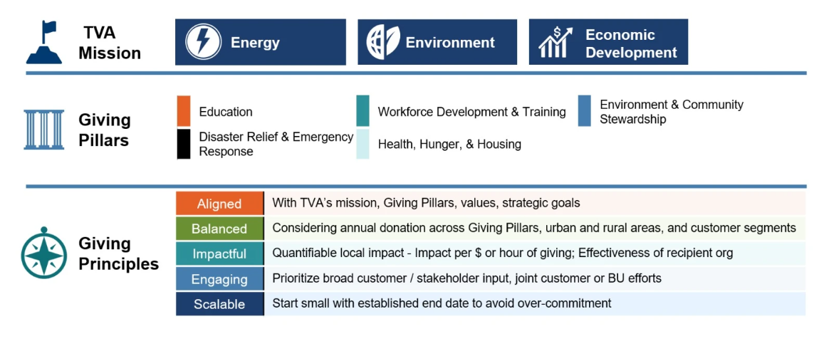



Communities
Enhancing TVA’s role as a community leader and trusted partner to make life better for the people of the Tennessee Valley
TVA Restricted Information – Deliberative and Pre-Decisional Privileged
Notes:
Our community, government, and stakeholder relations teams are working closely with customers and stakeholders to redefine TVA’s Community Engagement framework.
In addition to the general public, community organizations and non-profits, and business leaders - our community stakeholders really span across all of our stakeholder groups
Together, we are identifying opportunities to serve and partner on programs for lasting, positive impact. These Community Engagement efforts go hand in hand with communications strategies for sharing the TVA story, educating people about public power and how our three E’s benefit those we serve.
We’re focused on enhancing engagement through Contributions, Volunteerism, Valley Programs and Partnerships, and Civic and Board Participation. Just last year, our team engaged in over 100 volunteer events, coordinated community support after multiple devastating natural disasters, and distributed $2.5 million dollars in Community Contributions targeted across 7 new giving pillars.
We also have several Valley Programs that have been successful - like our $1 Million in annual STEM grants that we provide in partnership with TVA Retirees organization Bicentennial Volunteers (BVI) and our partnerships with United Way Organizations across Tennessee
And these are just a few examples
We are excited to build on this progress in the coming year and will provide more in depth review on community contribution, giving pillars, programs and frameworks in our External Stakeholder committee meetings.

Slide 22
Notes:
The efforts we’ve discussed here will make life better for our neighbors in the Valley region and deliver American energy security. They will serve, as Roosevelt put it, “the general social and economic welfare of the Nation.” ​
​
Thank you.

